Slide 1

Analyzer Overview
Jian, hanbin 2013-9-9

Slide 2
Analyzer
Test automation for electroplating additive analysis
Support 6 analysis methods
Dilution Titration
Linear Approximation Technique
Response Curve
Suppressor-Accelerator Relation
Pre-Addition of Leveler
Linear Regression Technique
2
Notes:
This analyzer is a test automation solution for electroplating additive analysis

Slide 3
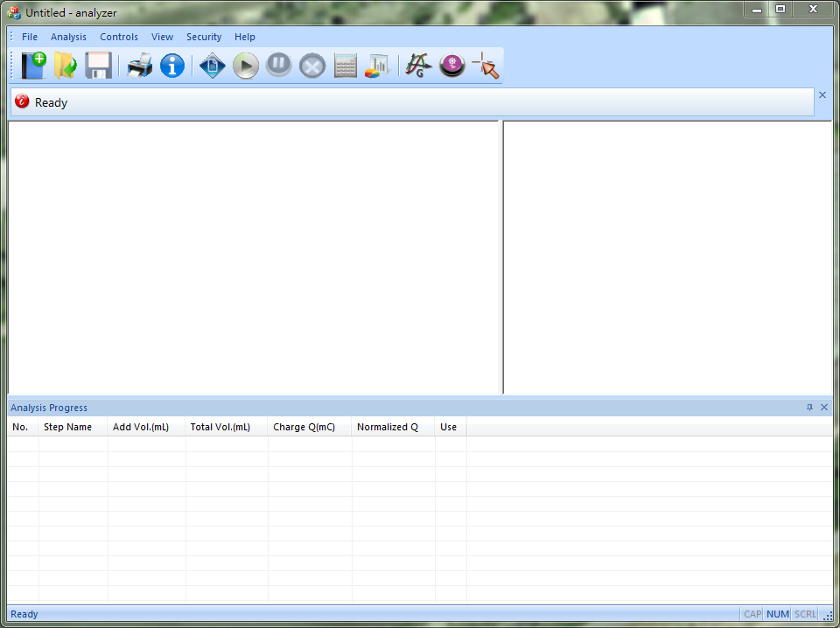
Main window
Title 01 (Arial, 22pt, bold) This is sample text. (Arial, 22pt)
Title 02 This is sample text.
menu
toolbar
caption bar
Left view
Right view
Output window
Status bar
3
Notes:
This is the analyzer, from top to bottom, we have a main menu, a toolbar, a caption bar, two views, an output window and a status bar.

Slide 4
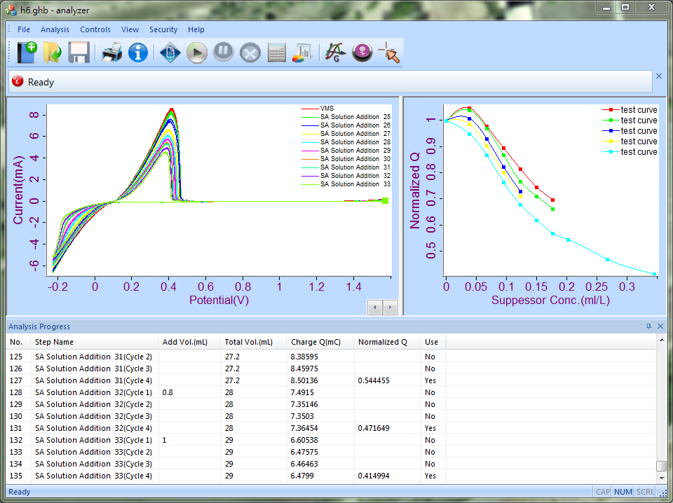
Main window
Title 01 (Arial, 22pt, bold) This is sample text. (Arial, 22pt)
Title 02 This is sample text.
menu
toolbar
caption bar
Left view
Right view
Output window
Status bar
4
Notes:
This is the analyzer, from top to bottom, we have a main menu, a toolbar, a caption bar, two views, an output window and a status bar.

Slide 5
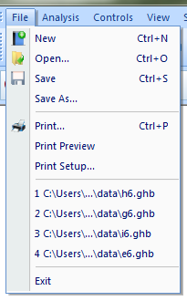
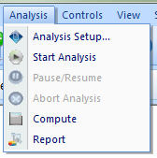
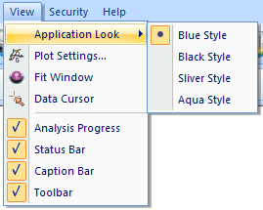



Menu&Toolbar
file
analysis
view
5
Notes:
Here shows the detailed menu items. Basic functions like file operation, data analysis and data display are complete, other function in control menu and security menu will add in the future. Below is the toolbar, provide a direct access to the basic functions.

Slide 6
Example
Open/Save data file(*.ghb)
New->Analysis setup->Save
Print data curve
Read data from plot
Generate pdf report
Change style
Application look & Plot settings
Do analysis task
SAR-analyze bath sample
6
Notes:
Now I will show how to use the analyzer software with six examples.
1.When start analyzer, it will automatically open a new data file, Now set the parameters in the analysis setup dialog.
A popup dialog will show when analysis setup is clicked. There are three tabs for different parameters.
First tab is analysis parameters, you need to select analysis type. And other parameters using for the result computation.
When analyze bath sample, the calibration file is also needed.
Second tab is CV parameter, mainly used to calculate the charge of each cycle.
Last tab is solution addition parameters, we have an editable step list.
Of each step, ‘type’ item specify the addition method , there are five types: VMS, volume once, volume interval, concentration once, concentration interval.
Solution composition is specified by SAL concentration, if the solution is a composition unknown sample, we set SAL all zero.
For volume interval and concentration interval addition method, we need to set an end point ratio, for most case, when charge ratio go below the end ratio, this step ends, but when adding accelerator, step ends when charge ratio go above the end ratio.
the extension of analyzer data file is ghb, the ghb file is to save all the parameters in analysis setup, and it may also save the experimental data.
Now analyzer generates a data file without the experimental data.
We open another file with experimental data, we see analyzer will show the raw data curve and test data curve in its two view.
2.And we may print these two graph. And we can preview the printing.
3.when the mouse enter the plotting region, mouse cursor become a cross and a tooltip will show the coordinate of the cross center. To read data point, just click the data cursor button, and click at the graph near the point.
we may use the mouse wheel to zoom in or out , and drag to move the curve. To show all, just click the fit window.
4.Analyzer can generate report. Click report button, and choose report content and file name. this is the report.
5.We can change the software style. There are four styles. Each style has three color styles in plot setting.
6.Now I will show you how to do analysis. First setup the analysis parameters, you need to select analysis type and fill this step list, or just load the parameters from a exist file. And click start. Before each step, analyzer will pause and caption bar will show the volume of solution to add. After added, click continue. Volume and charge data show in the below output window. You may pause or stop the process, When all steps finish, analyzer compute the result and show at the caption bar.

Slide 7
End of Presentation
Thank you. Questions are welcome.
Our corporate website: www.astri.org

